Slide 1
Cryptographic Algorithm Analysis
Performance analysis using multimedia contents

Slide 2
With Text

Slide 3
Text Encryption
Size (kb) | 1 | 10 | 50 | 100 | 200 | 300 | 400 | 500 | 600 | 700 | 800 | 900 | 1024
Blowfish (millisecond) | 1 | 1 | 1 | 1 | 2 | 4 | 5 | 7 | 8 | 9 | 11 | 17 | 21
AES (millisecond) | 0 | 0 | 1 | 1 | 1 | 1 | 2 | 2 | 2 | 3 | 3 | 3 | 3
XOR (millisecond) | 0 | 1 | 1 | 2 | 4 | 5 | 6 | 116 | 143 | 229 | 356 | 358 | 489
RSA (millisecond) | 181 | 1743 | 9152 | 17177 | 36814 | 51937 | 73216 | 87000 | 106800 | 126017 | 143206 | 162905 | 181248

Slide 4
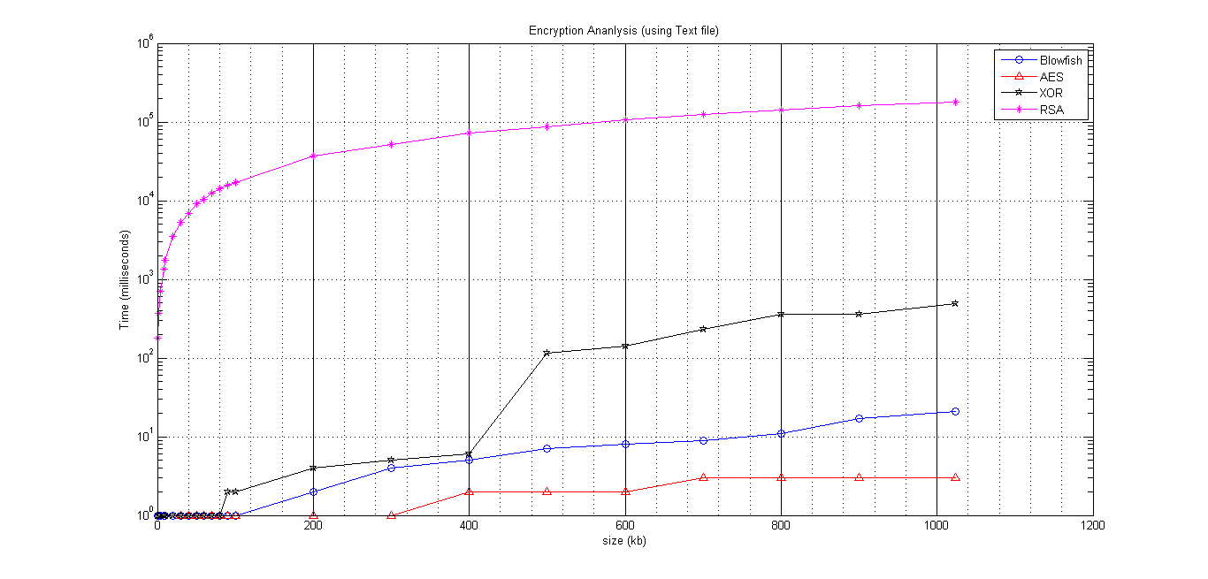
Text Encryption Comparison Graph

Slide 5
Comparison (Text Encryption)
Algorithm | Data Processed (kilobyte) | Time taken (milliseconds) | Speed (kb/millisecond) | Average Time (milliseconds)
Blowfish | 5989 kb | 98 | 61.11 kb/ms | 4.26
AES | 5989 kb | 28 | 213.89 kb/ms | 1.22
XOR | 5989 kb | 1721 | 3.48 kb/ms | 74.82
RSA | 5989 kb | 922610 | 0.0065 kb/ms | 40113

Slide 7
Text Decryption
Size(kb) | 1 | 10 | 50 | 100 | 200 | 300 | 400 | 500 | 600 | 700 | 800 | 900 | 1024
Blowfish (millisecond) | 1 | 1 | 1 | 2 | 3 | 5 | 6 | 10 | 14 | 14 | 16 | 19 | 22
AES (millisecond) | 0 | 1 | 1 | 1 | 1 | 1 | 1 | 2 | 2 | 2 | 2 | 2 | 2
XOR (millisecond) | 1 | 1 | 2 | 3 | 5 | 6 | 7 | 8 | 9 | 14 | 14 | 19 | 24
RSA (millisecond) | 668 | 6573 | 34176 | 65841 | 135291 | 202936 | 267200 | 332517 | 396102 | 469120 | 534410 | 601221 | 681984

Slide 8
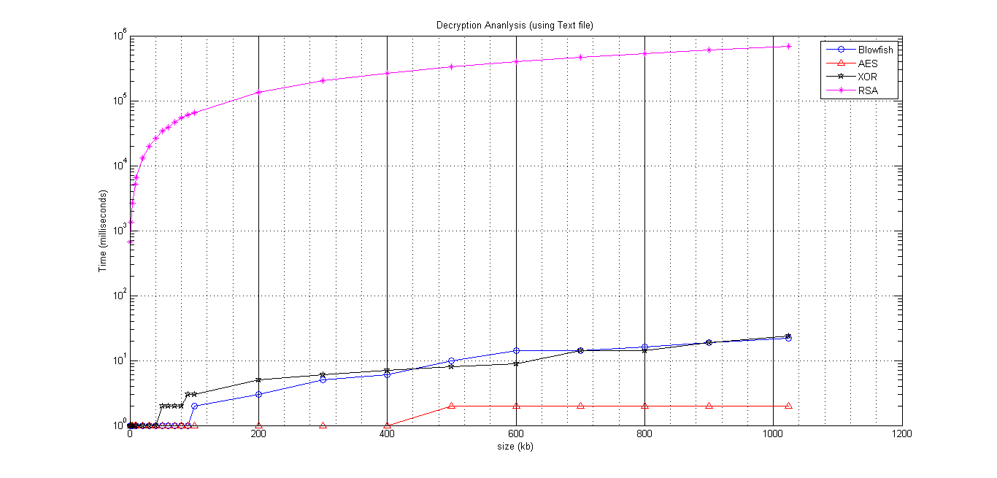
Text Decryption Comparison Graph

Slide 9
Comparison (Text Decryption)
Algorithm | Data Processed (kilobyte) | Time taken (milliseconds) | Speed (kb/millisecond) | Average Time (milliseconds)
Blowfish | 5989 kb | 124 | 48.3 kb/ms | 5.39
AES | 5989 kb | 28 | 213.89 kb/ms | 1.22
XOR | 5989 kb | 128 | 46.79 kb/ms | 5.57
RSA | 5989 kb | 3997394 | 0.0015 kb/ms | 173799

Slide 10
With Monochrome Image

Slide 11
Monochrome Image Encryption
Size(kb) | 10 | 50 | 100 | 200 | 400 | 600 | 800 | 1000 | 1200 | 1400 | 1600 | 1800 | 2000 | 2200
Blowfish (millisecond) | 1 | 1 | 2 | 3 | 6 | 9 | 11 | 15 | 16 | 19 | 22 | 24 | 30 | 33
AES (millisecond) | 1 | 1 | 1 | 1 | 1 | 1 | 1 | 2 | 2 | 2 | 2 | 2 | 3 | 3
XOR (millisecond) | 2 | 7 | 17 | 29 | 58 | 87 | 122 | 152 | 188 | 210 | 242 | 274 | 305 | 360
RSA (millisecond) | 7 | 37 | 82 | 204 | 591 | 1166 | 1910 | 2806 | 3907 | 5270 | 6946 | 8880 | 11471 | 14345

Slide 12
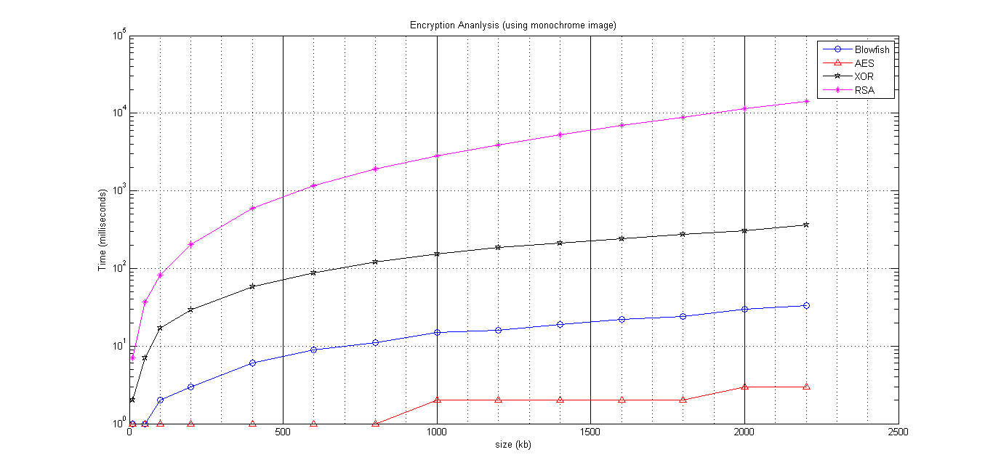
Monochrome Image Encryption Comparison Graph

Slide 13
Comparison (Monochrome Image Encryption)
Algorithm | Data Processed (kilobyte) | Time taken (milliseconds) | Speed (kb/millisecond) | Average Time (milliseconds)
Blowfish | 13360 kb | 192 | 69.58 kb/ms | 13.71
AES | 13360 kb | 23 | 580.87 kb/ms | 1.64
XOR | 13360 kb | 2053 | 6.5 kb/ms | 146.64
RSA | 13360 kb | 57622 | 0.23 kb/ms | 4115

Slide 14
Monochrome Image Decryption
Size (kb) | 10 | 50 | 100 | 200 | 400 | 600 | 800 | 1000 | 1200 | 1400 | 1600 | 1800 | 2000 | 2200
Blowfish (millisecond) | 1 | 1 | 2 | 3 | 6 | 9 | 12 | 15 | 18 | 22 | 25 | 28 | 31 | 35
AES (millisecond) | 1 | 1 | 1 | 1 | 1 | 1 | 2 | 2 | 3 | 3 | 3 | 4 | 5 | 6
XOR (millisecond) | 2 | 7 | 17 | 29 | 58 | 87 | 122 | 152 | 188 | 210 | 242 | 274 | 305 | 360
RSA (millisecond) | 117 | 590 | 1218 | 2443 | 5174 | 7777 | 10542 | 14127 | 16922 | 20008 | 24023 | 27234 | 31561 | 36560

Slide 15
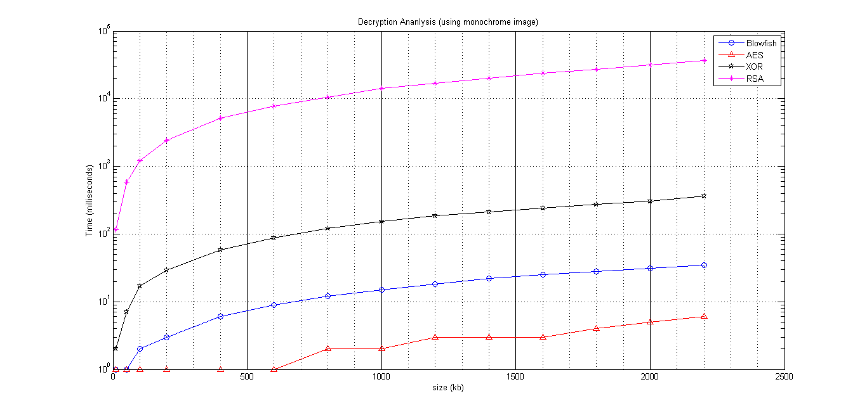
Monochrome Image Decryption Comparison Graph

Slide 16
Comparison (Monochrome Image Decryption)
Algorithm | Data Processed (kilobyte) | Time taken (milliseconds) | Speed (kb/millisecond) | Average Time (milliseconds)
Blowfish | 13360 kb | 208 | 64.23 kb/ms | 14.86
AES | 13360 kb | 34 | 392.94 kb/ms | 2.43
XOR | 13360 kb | 2053 | 6.5 kb/ms | 146.64
RSA | 13360 kb | 198296 | 0.067 kb/ms | 14164

Slide 17
With Color Image

Slide 18
Color Image Encryption
Size(kb) | 10 | 50 | 100 | 200 | 300 | 500 | 700 | 900 | 1100 | 1300 | 1500 | 1700 | 1900
Blowfish | 1 | 1 | 3 | 3 | 4 | 7 | 9 | 12 | 15 | 17 | 22 | 22 | 26
AES | 1 | 1 | 1 | 1 | 1 | 1 | 1 | 1 | 2 | 2 | 2 | 3 | 3
XOR | 3 | 7 | 16 | 33 | 45 | 78 | 116 | 143 | 187 | 194 | 231 | 258 | 304
RSA | 7 | 38 | 85 | 212 | 368 | 831 | 1493 | 2328 | 3377 | 4564 | 6096 | 7926 | 11180

Slide 19
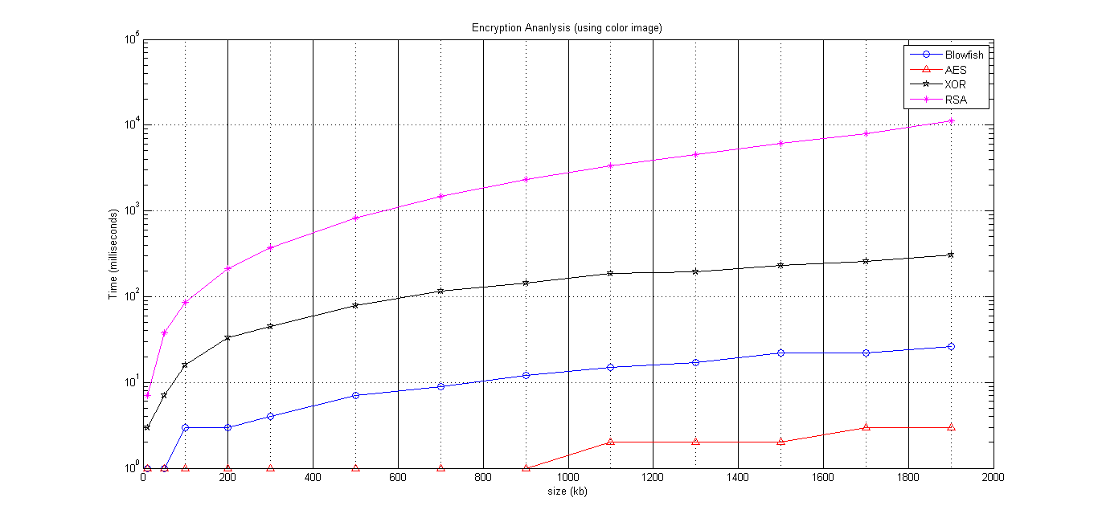
Color Image Encryption Comparison Graph

Slide 20
Comparison (Color Image Encryption)
Algorithm | Data Processed (kilobyte) | Time taken (milliseconds) | Speed (kb/millisecond) | Average Time (milliseconds)
Blowfish | 10260 kb | 142 | 72.25 kb/ms | 10.92
AES | 10260 kb | 20 | 513 kb/ms | 1.54
XOR | 10260 kb | 1615 | 6.35 kb/ms | 124.23
RSA | 10260 kb | 38505 | 0.27 kb/ms | 2962

Slide 21
Color Image Decryption
Size(kb) | 10 | 50 | 100 | 200 | 300 | 500 | 700 | 900 | 1100 | 1300 | 1500 | 1700 | 1900
Blowfish | 1 | 1 | 2 | 3 | 4 | 7 | 10 | 12 | 14 | 18 | 21 | 23 | 27
AES | 1 | 1 | 1 | 1 | 1 | 1 | 1 | 2 | 2 | 3 | 4 | 4 | 5
XOR | 3 | 7 | 16 | 33 | 45 | 78 | 116 | 143 | 187 | 194 | 231 | 258 | 304
RSA | 113 | 617 | 1223 | 2424 | 3755 | 6264 | 9250 | 12202 | 15710 | 18460 | 21952 | 25722 | 31278

Slide 22
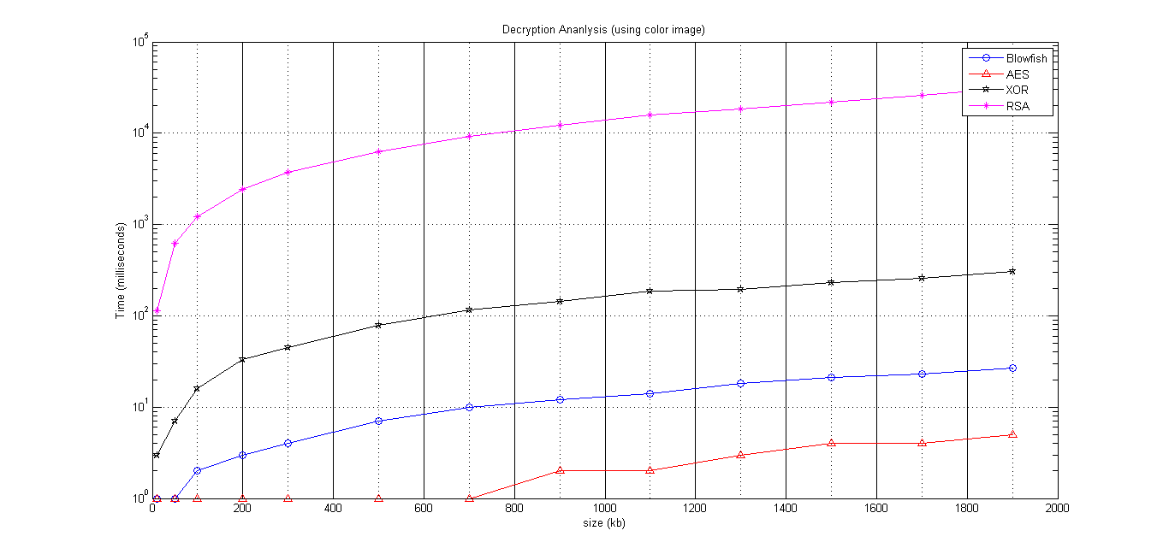
Color Image Decryption Comparison Graph

Slide 23
Comparison (Color Image Decryption)
Algorithm | Data Processed (kilobyte) | Time taken (milliseconds) | Speed (kb/millisecond) | Average Time (milliseconds)
Blowfish | 10260 kb | 143 | 71.74 kb/ms | 11
AES | 10260 kb | 27 | 380 kb/ms | 2.08
XOR | 10260 kb | 1615 | 6.35 kb/ms | 124.23
RSA | 10260 kb | 148970 | 0.69 kb/ms | 11459.23

